Slide 1

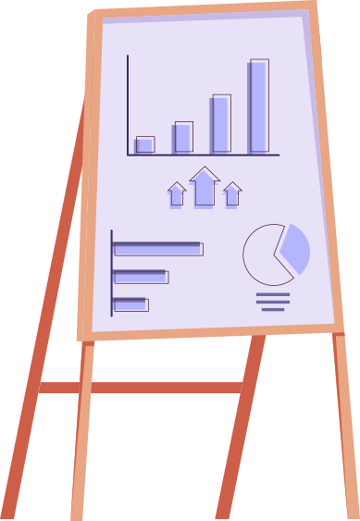


# Solver

Slide 2

Problem
Who will treat the doctor?
As a Computer science Students we are Required to solve people’s problems, but who will solve our problems?

Slide 3





MAIN PROBLEMS
difficulty
Learning process
Another challenge as students is the studying process time management and the studying materials
One of the problems we face is the difficulty of the courses we study

Slide 4

RESULTS
Who will treat the doctor?
In turn that will lead to serious problems for the students and also for those who want to take computer science as a major

Slide 5


In turn that will lead to serious problems for the students and also for those who want to take computer science as a major

Slide 6
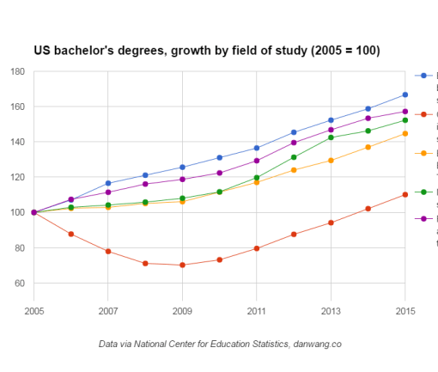
Increasing percentage
45%
52%
Engineering
mathematics and statistics
67%
9%
biological and biomedical sciences
Computer science
Engineering
biological and biomedical sciences
mathematics and statistics
physical sciences and science technologies
Increasing of cs students vs other majors students

Slide 7

TABLE OF CONTENTS
INTRODUCTION TO OUR SOLVER
1
provides an overview of the program
THE PURPOSE OF THE PROGRAM
2
how does the program help? and who is its target audience.
THE PROGRAM STRUCTURE
3
The contants, process and the methods used

Slide 8


RUN!
Not you , but the program , let's solve your problems….

Slide 9
1
INTRODUCTION TO our solver

Slide 10
if(brain!=empty)
{
KeepCoding();
}
Else{
orderCofee();
}

Slide 11
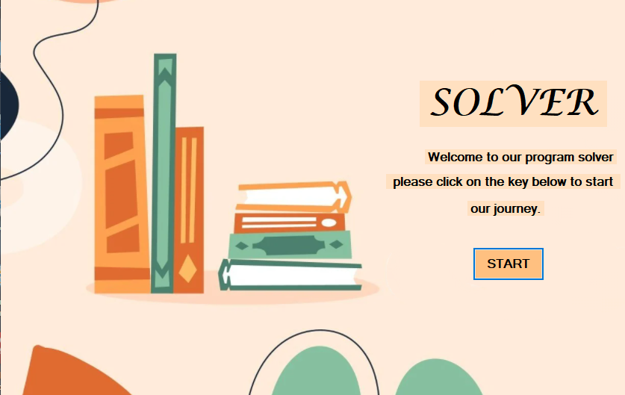
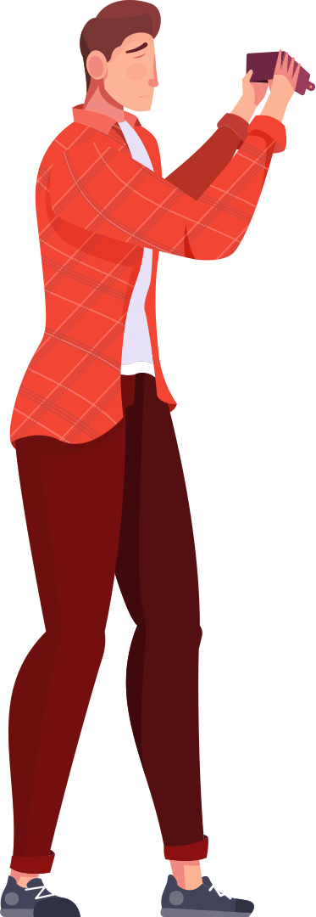
Windows Form app

Slide 12
METHODS AND TOOLS
The program helps CS students with their studies that it :
Solves problems in math , logic design and physics
has books and some information about professors
has an easy interface to use
Has a GPA Calculator and some games

Slide 13
learning objectives
01
02
03
04
Programming basics
OOP
Graphical interface
software management

Slide 14
Solver’s sections
Digital Logic & Design
Physics
Mathematics
Solves mathematical problems in matrices, sequence and vectors
The program solves the wave equations in physics in six chapters
A calculator Converts between decimal systems, a boolean algebra and logic simplification calculator and converts from truth table to functions.

Slide 15
Solver’s sections
GPA
Materials
GPA Calculator
Games
It contains books and lectures for materials and a brief background of each lecturer and ways to communicate with them.
Calculates the GBA for the subjects of the first year
Our program did not forget to entertain the user after studying, so we added two games to the program .

Slide 16
while noSuccess:
tryAgain()
if Success:
improve()

Slide 17
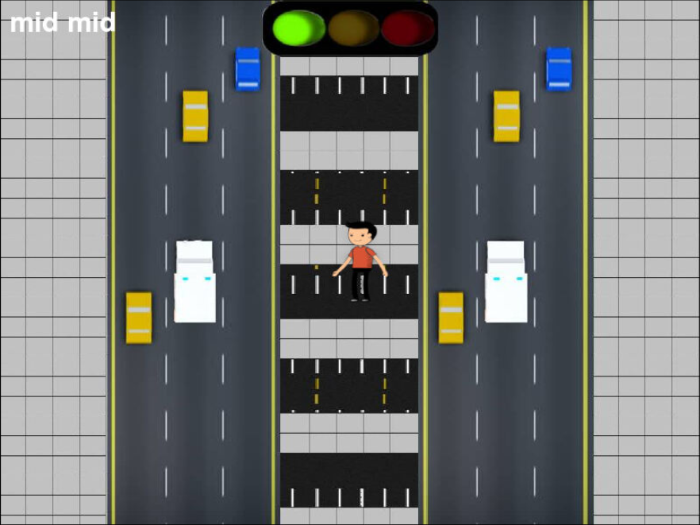

Python game
an interactive game made using python programming language and pygame library mainly made for kids

Slide 18
learning objectives
Concepts of OOP
Programming languages and libraries
Clean code

Slide 19
Game Features
attractive interface
Educational game for kids
Very attractive interface for any kind of user because it is made mainly for kids
this game also have an educational purpose which is teaching kids how they deal with traffic light

Slide 20
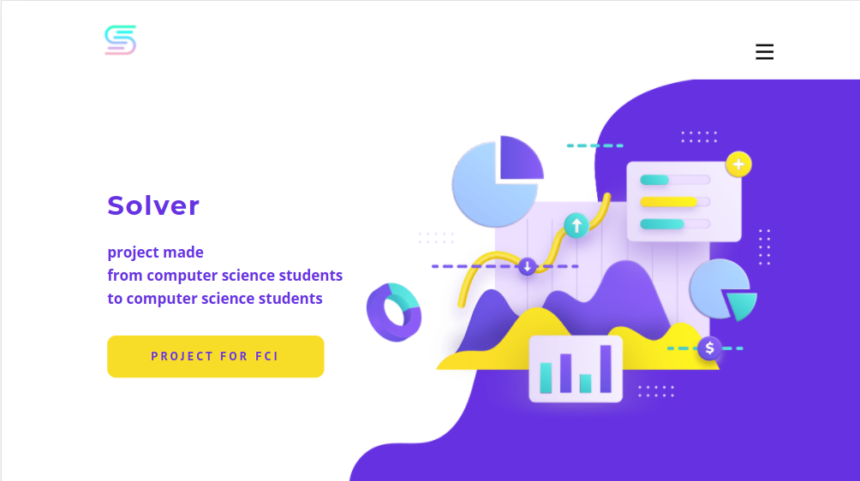
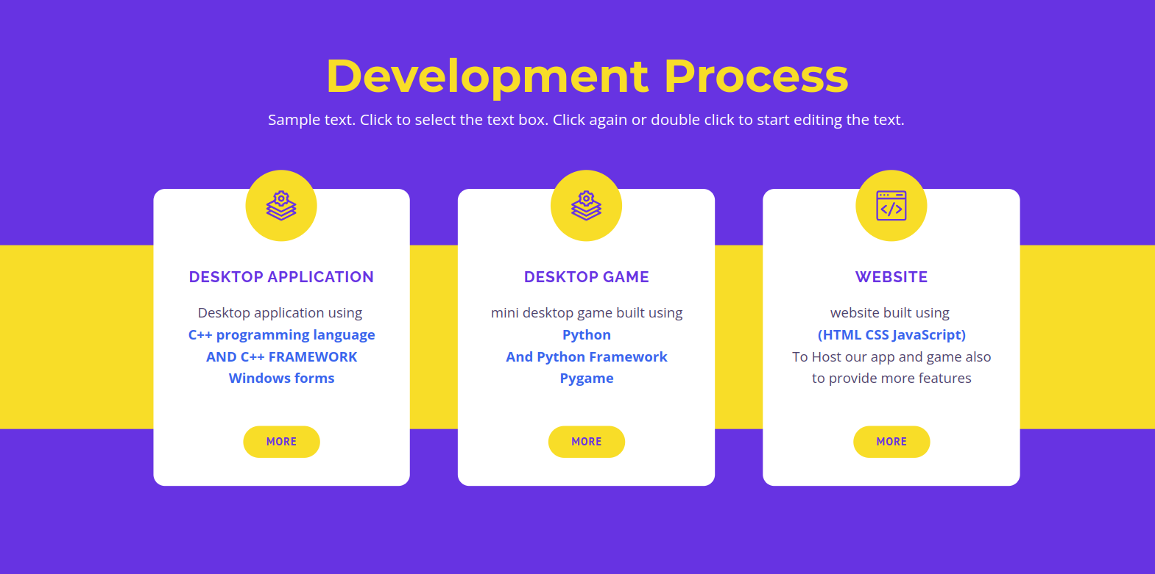
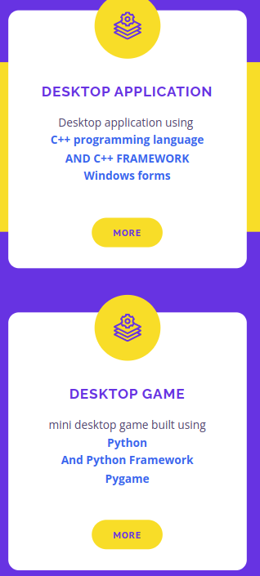
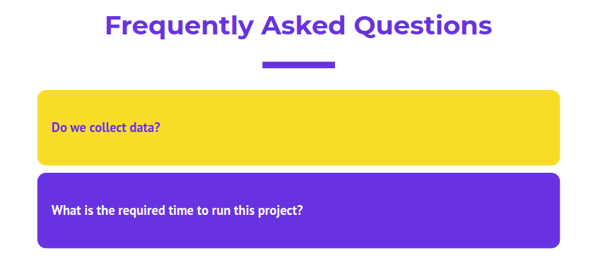
solver’s website

Slide 21
learning objectives
Web development
Open source community
networks and servers

Slide 22
WEBSITE
GPA CALCULATOR
FLOWCHART MAKER
ALARM
The program Allows you to make a flowcharts for your code in easier way
an Alarm clock to follow studying techniques such as pomodoro technique
A calculator Converts between decimal systems, a boolean algebra and logic simplification calculator and converts from truth table to functions.

Slide 23
FEATURES
LARGER AUDIENCE
Everyone nowadays uses websites
HOST MORE FEATURES
Better UX
Such as FLOWCHART MAKER
Everyone knows how to deal with websites

Slide 24

+5,000,000,000
Internet users in the world in 2022

Slide 25
“we had a problem,we decided to write a program to solve that. Now we have 1 problem, 9 errors and 332 warnings.”
—confusedprogrammers

Slide 26
RESOURCES
websites :
Stack overflow
Greeks for Greeks
Code Grepper
programiz
Quora
Reddit
Code project
GitHub

Slide 27



Solvers
Hussien Hany Hussien
Sherif Khairy Amin
Hussien Saad Hussien
hhany3997@gmail.com
Linkedin||GitHub
FCI Fayoum university student
Jr. Software Engineer
Algorithm maker & coder
Sherif.yato@gmail.com
Linkedin||GitHub
FCI Fayoum university student
Jr. Embedded Software Engineer
GUI & Algorithm coder
hussein.saad2021@gmail.com
Linkedin||GitHub
FCI Fayoum university student
Jr.competitive programmer
Algorithm maker & coder

Slide 28
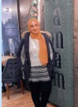

Shahd Mohamed Ali
Aya Ahmed Belal
shahdosman9071@gmail.com
Linkedin||GitHub
FCI Fayoum university student
Jr. Embedded Software Engineer
GUI & Algorithm coder
ayabelal906@gmail.com
Linkedin||GitHub
FCI Fayoum university student
Jr. Web developer
Algorithm maker & coder

Slide 29
THANKS!
Do you have any questions?
Feel free to contact me ,
sk1444@fayoum.edu.eg
01101519464
project link : GitHub

